Slide 1
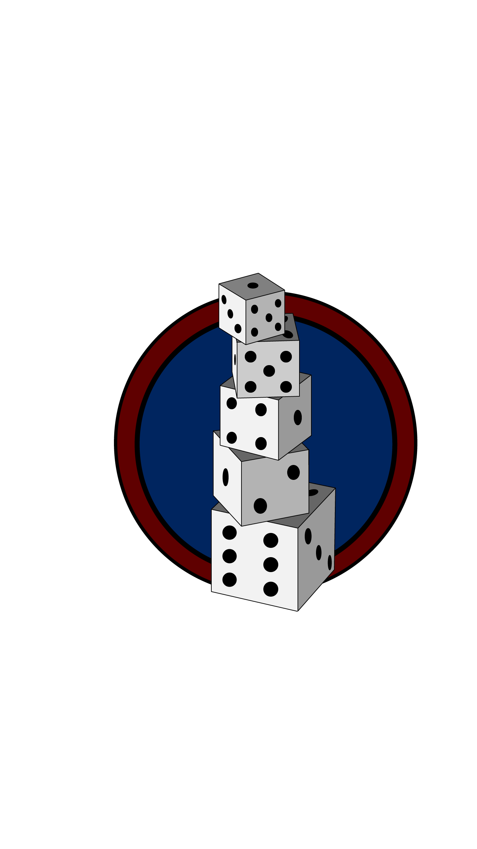
FiveDice
A game created by:
Turony Evelin
Babos Dávid
Deé Lukács András Gergely
Derzsi Dániel

Slide 2
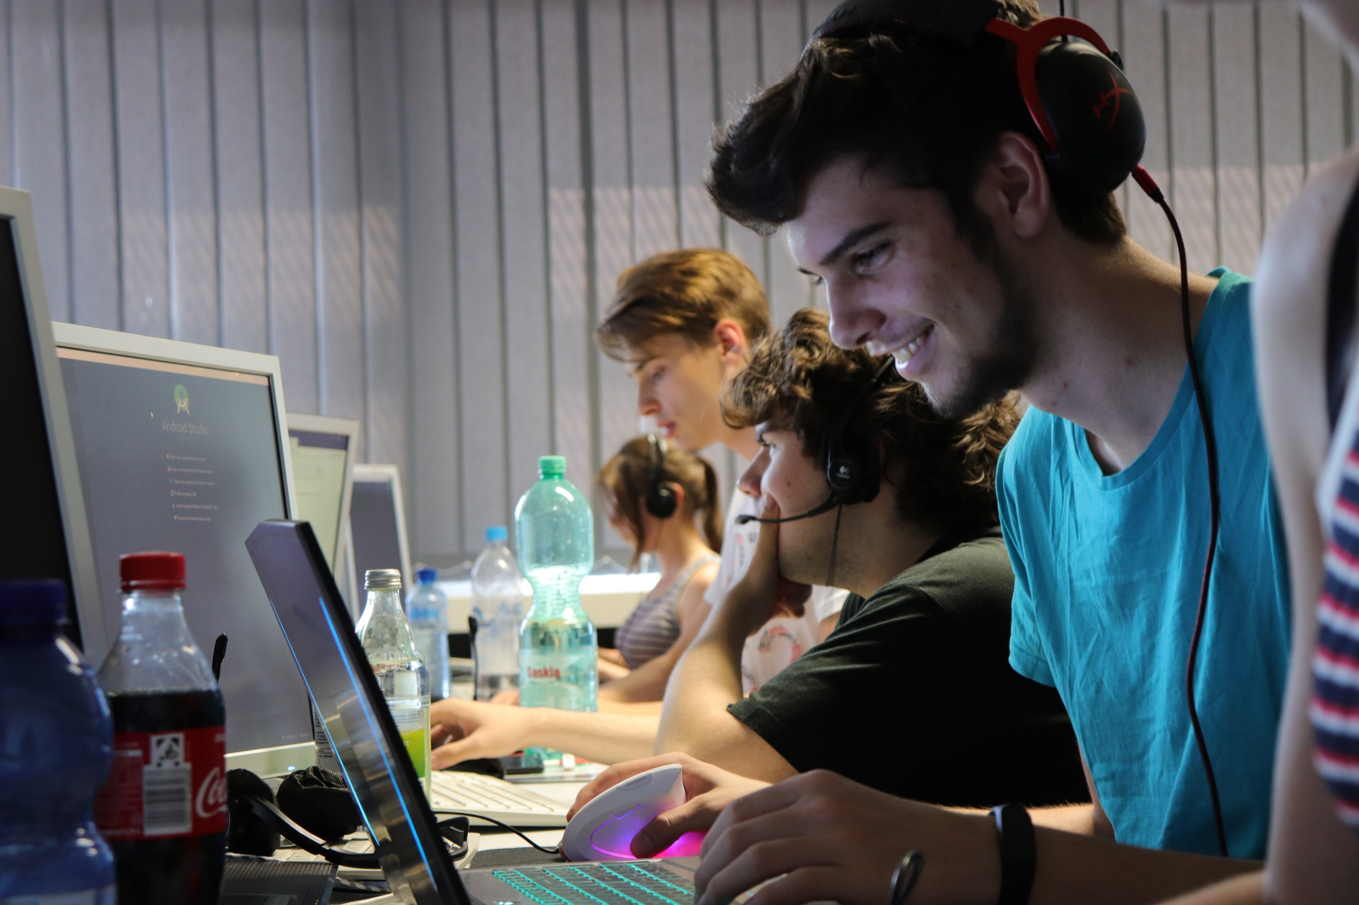
The story
The project was created in frame of an Erasmus program.
And this is our final work with all of our experiences gathered this time.

Slide 3
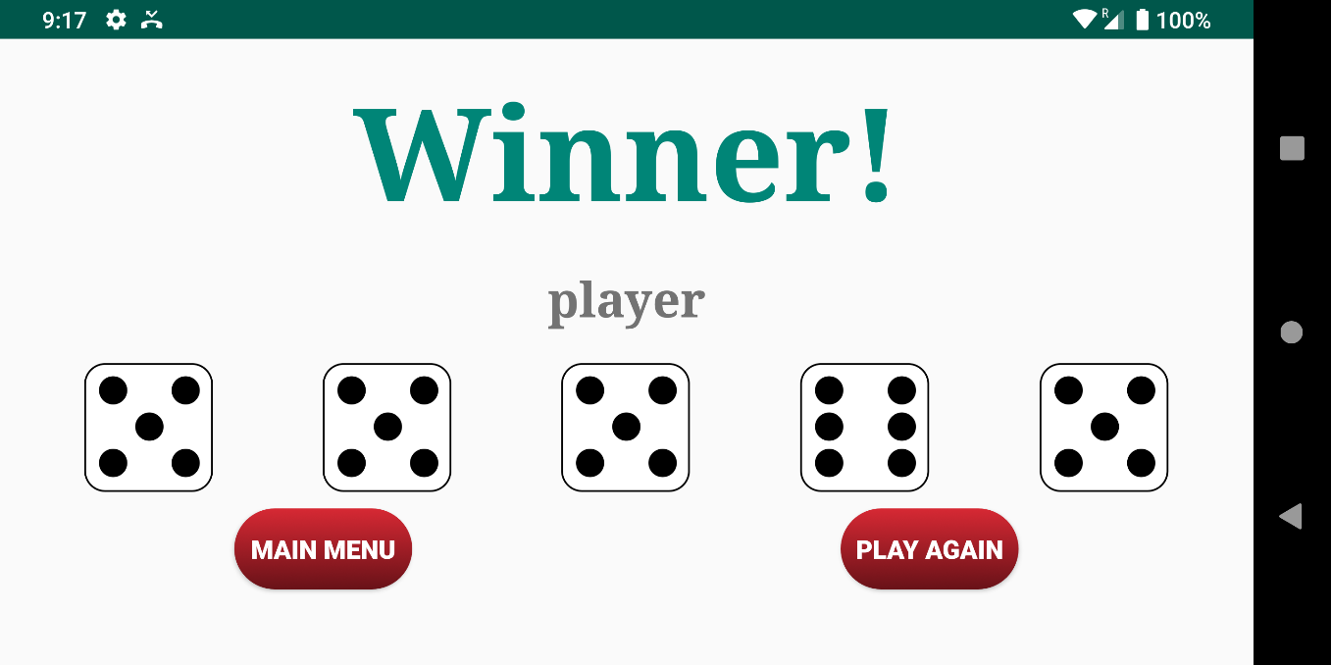
The essence of the game
Simple distractive game
2 Game modes:
Player vs. Player
Player vs. AI
Gameplay:
Each player has 5 dices and 3 rounds to throw them.
Players can keep or discard dices.
After the 3 throws the points will be added.
The first one who reaches the score threshold wins.

Slide 4
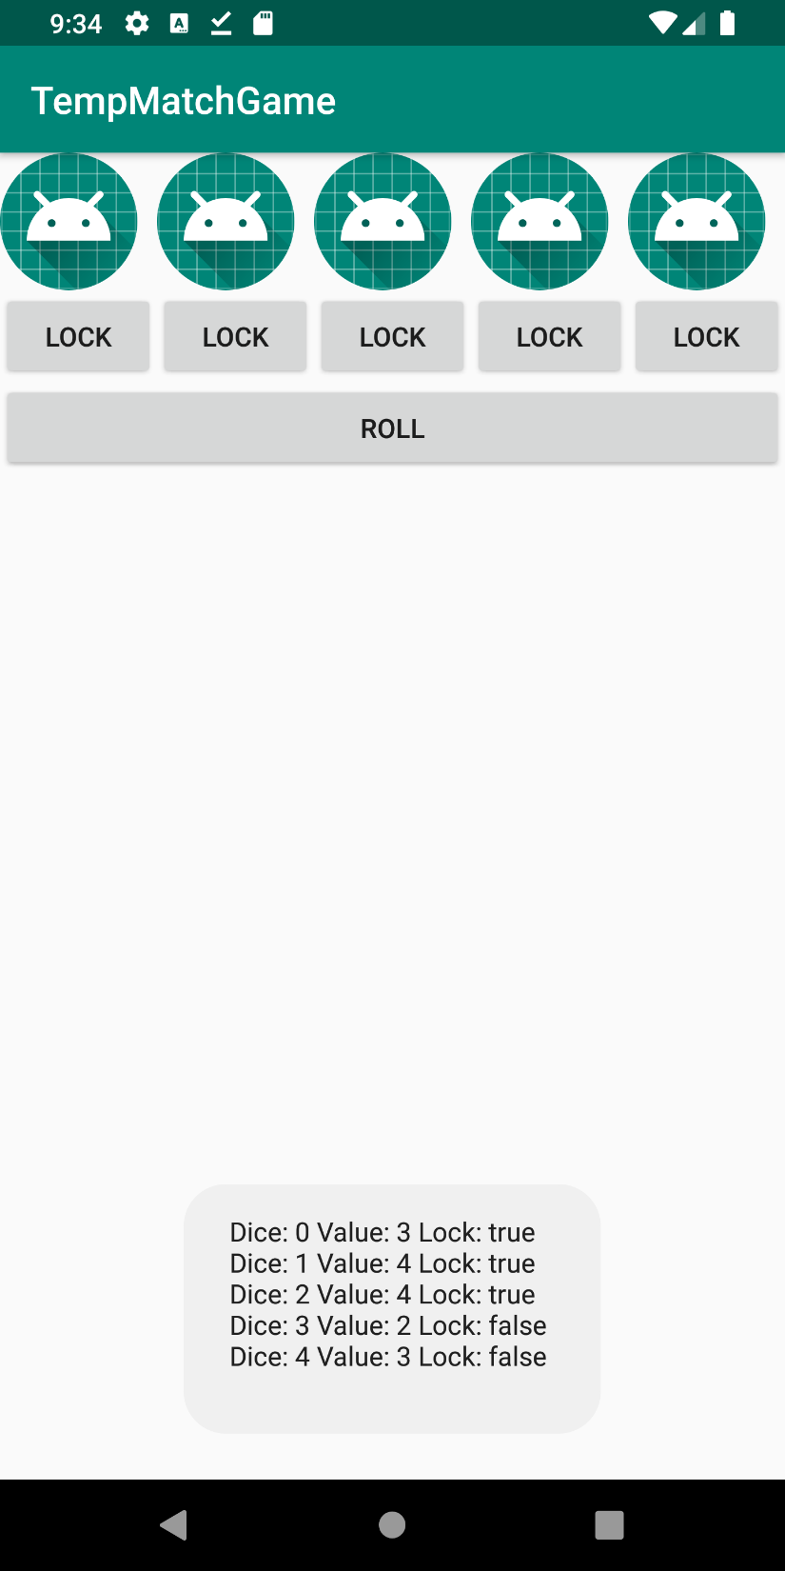
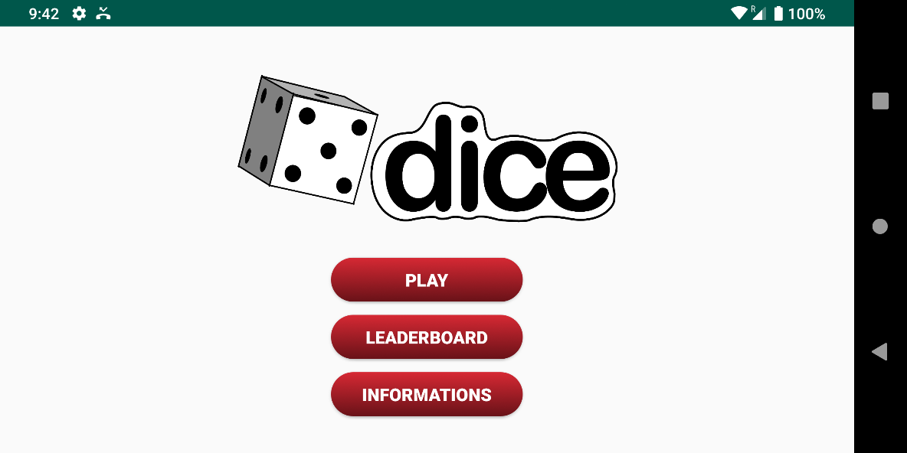
Our areas of focus
Firstly we mainly focused on the base algorithm
Then we added extras and design

Slide 5
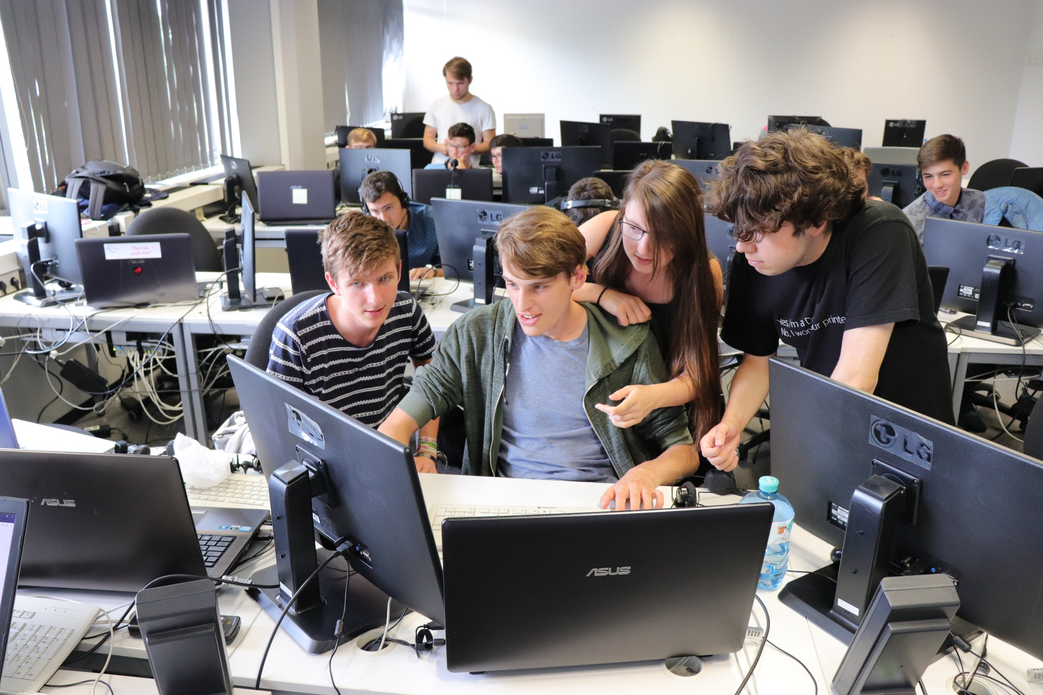
Our steps in developement
1. Brainstorming

Slide 6
2. Created the template game with 1 activity

Slide 7
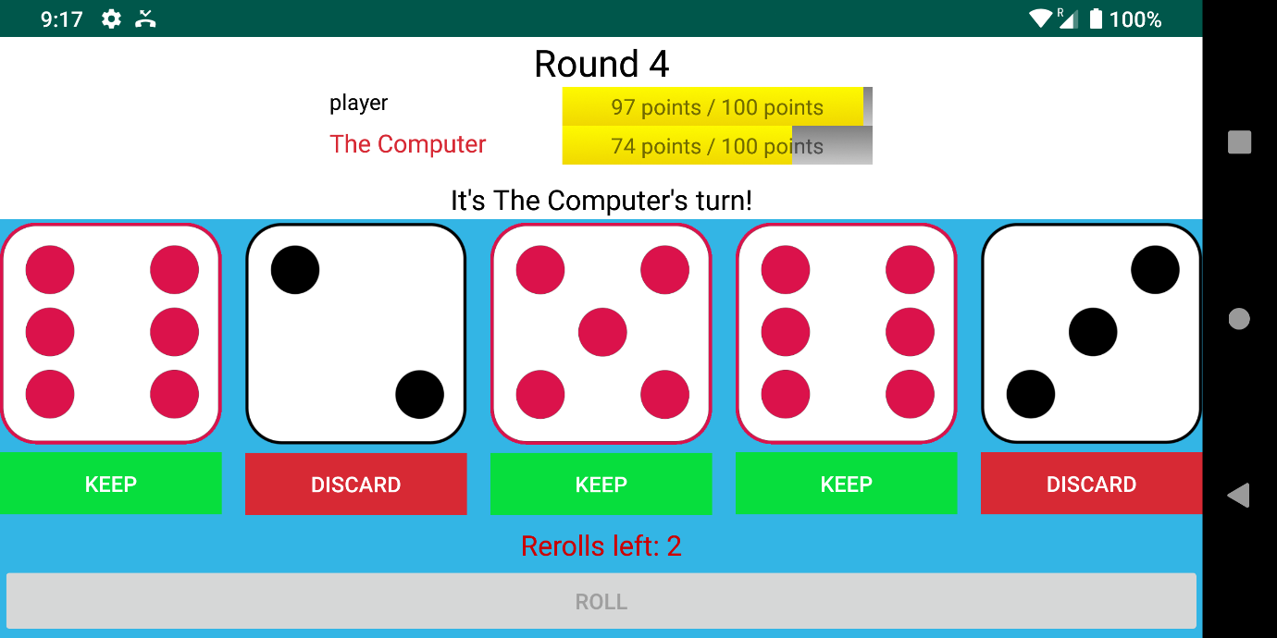
3. We rewrote and redesigned the whole game

Slide 8
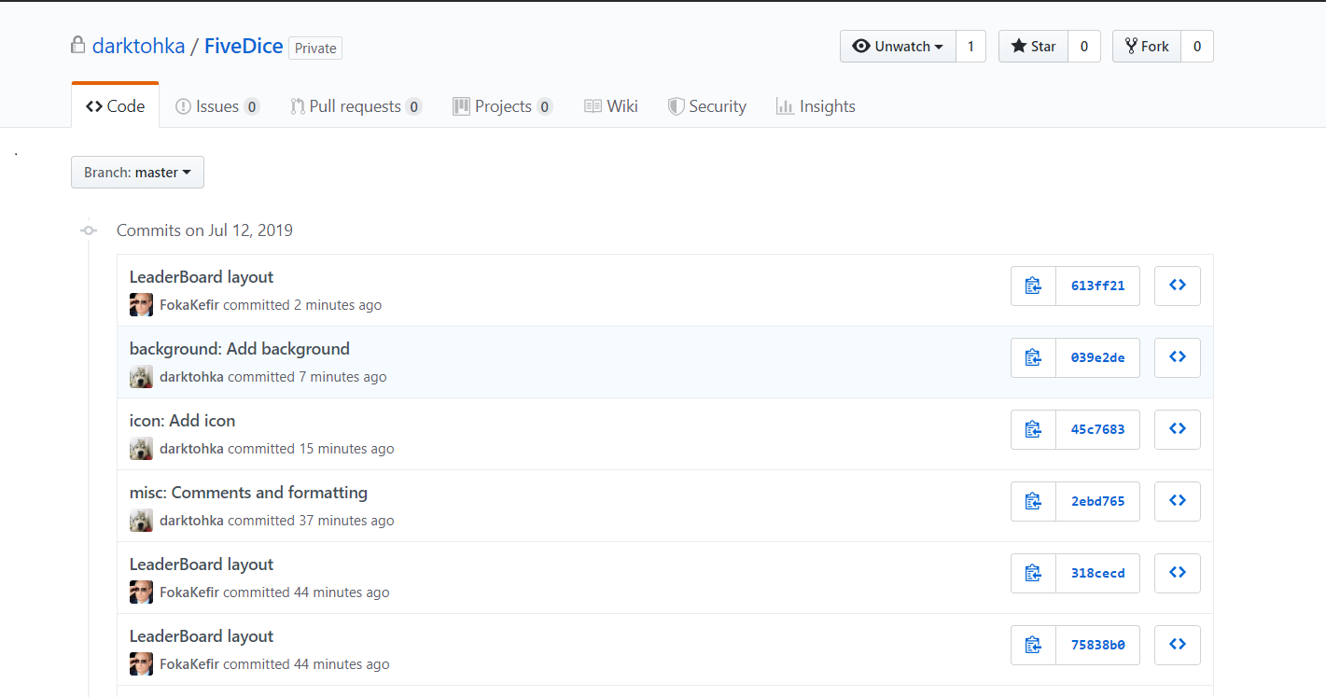
4. We worked in teams so we introduced GitHub

Slide 9
5. Creation of the IntroActivity
Here’s the game mode selection
Player names
Winner score threshold

Slide 10
6. Creation of the Menu

Slide 11
7. Creation of Leaderboard with database

Slide 12
8. Creation of the AI

Slide 13
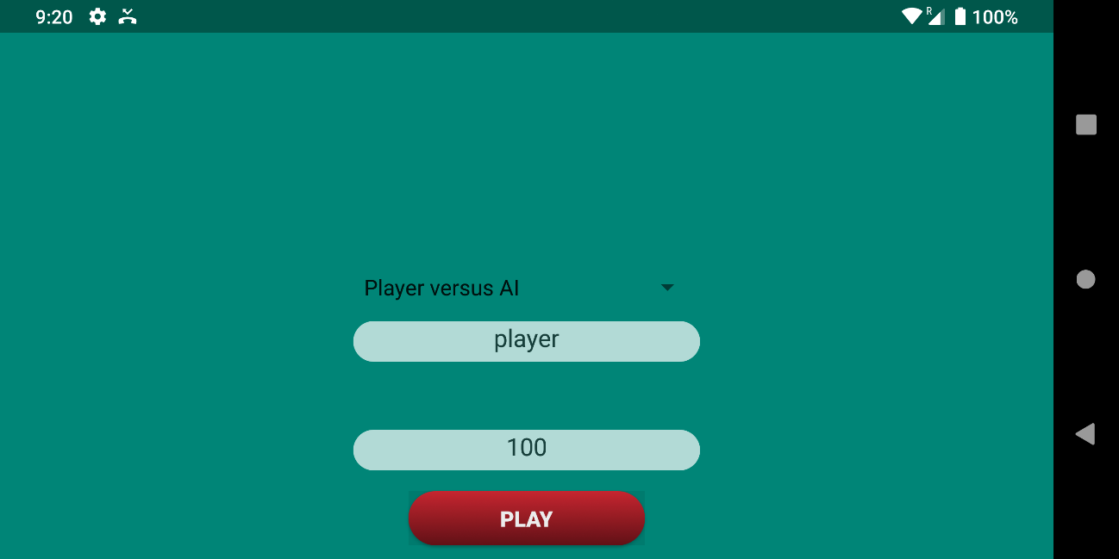
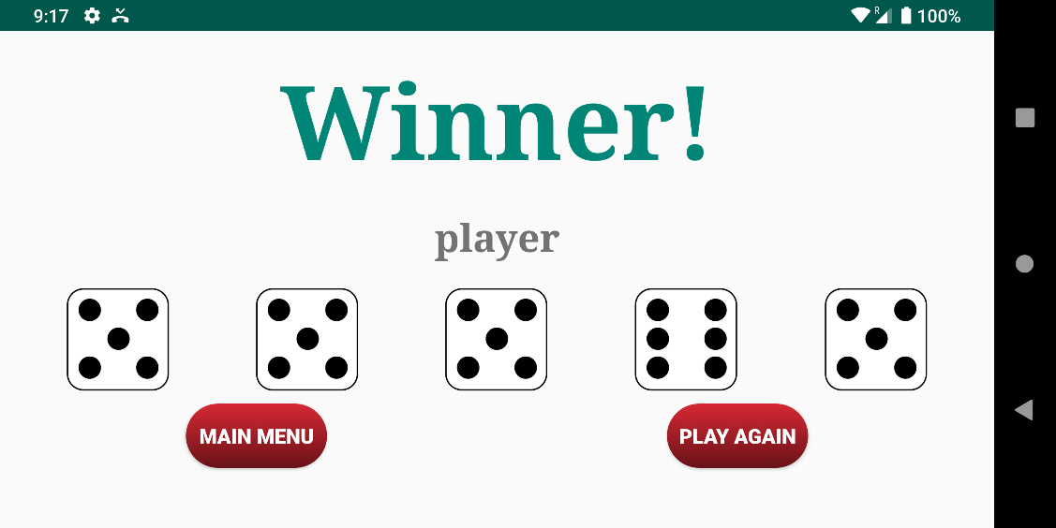
9. Putting it all together

Slide 14
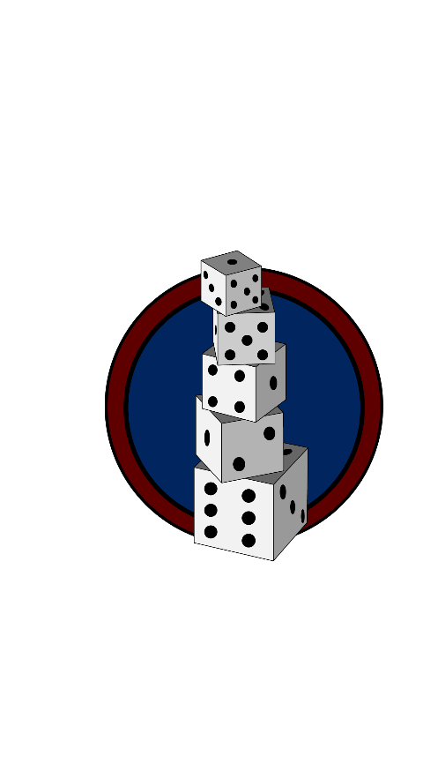
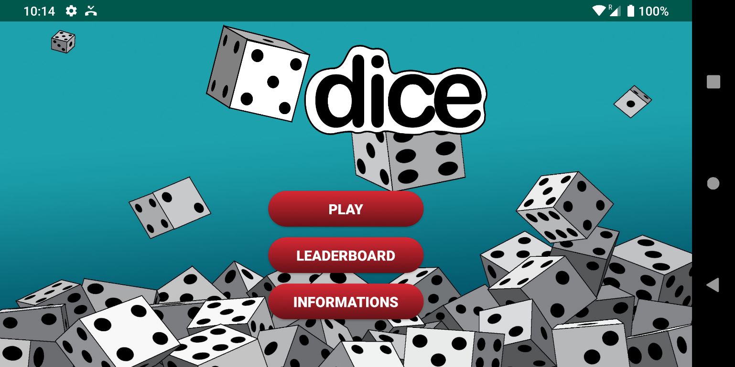
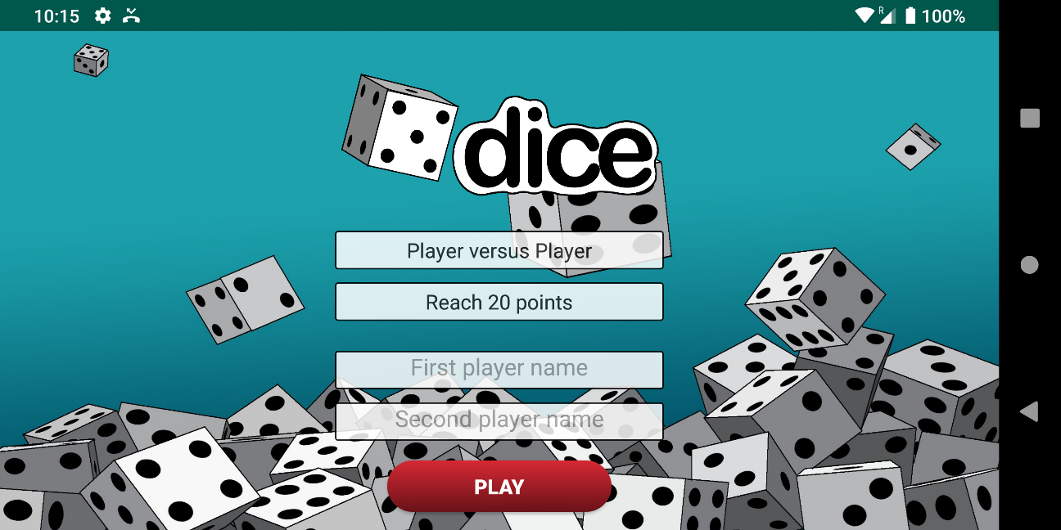
10. Integration of the new design

Slide 15
MainActivity
IntroActivity
LeaderboardActivity
InfoActivity
GameActivity
WinnerActivity

Slide 16
Our future plans
Points given based on combinations
Audio effects
Multiplayer with Bluetooth functionality
Upload the game in the Google Play Store.

Slide 17
Thank you for your attention!

