Slide 1
Moments
László Ákos
Radu Gloria Alexia
Zöldi Tamás Botond
Fülöp Koppány-Bence

Slide 2
The idea
Productivity
Personal improvement
?
Simplify people’s life

Slide 3
What can it be used for?
Journal
Analyser
Tracker
Memory keeper

Slide 4
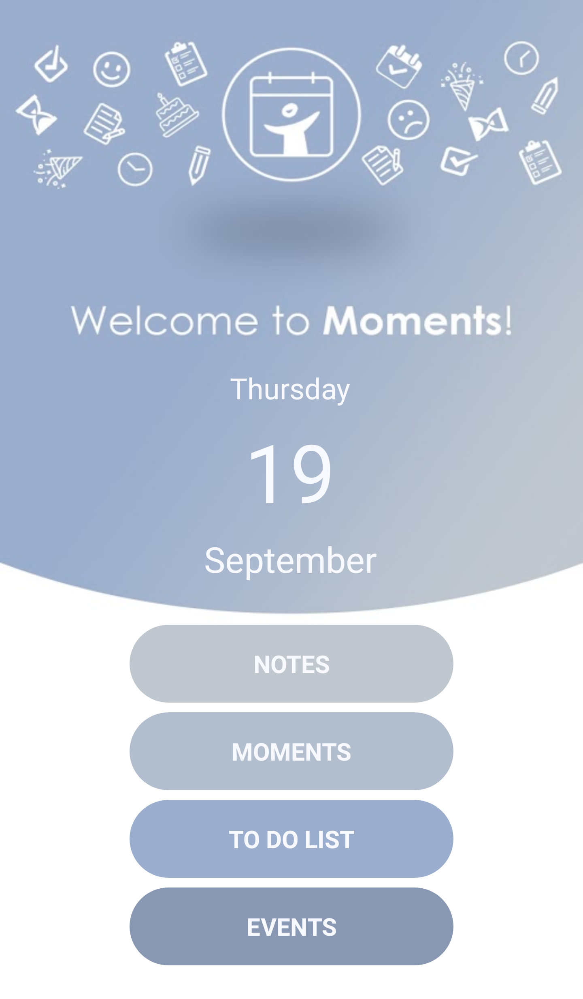
Main features
Welcome page

Slide 5
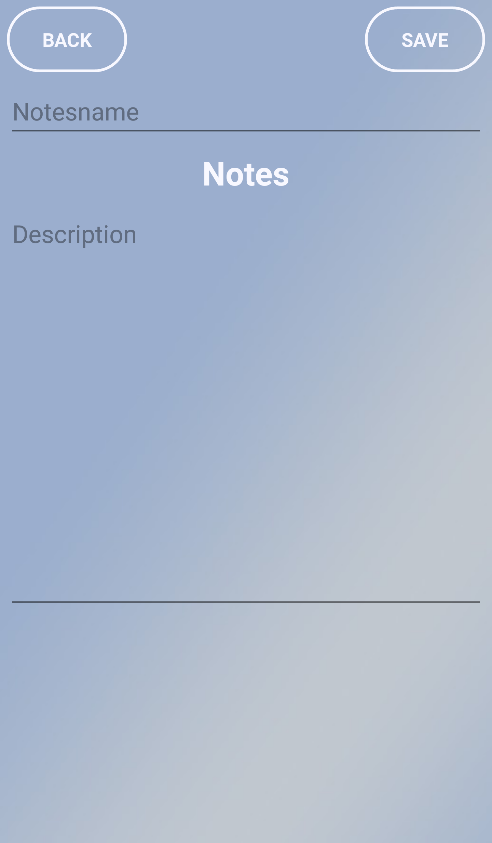
Main features
Notes

Slide 6
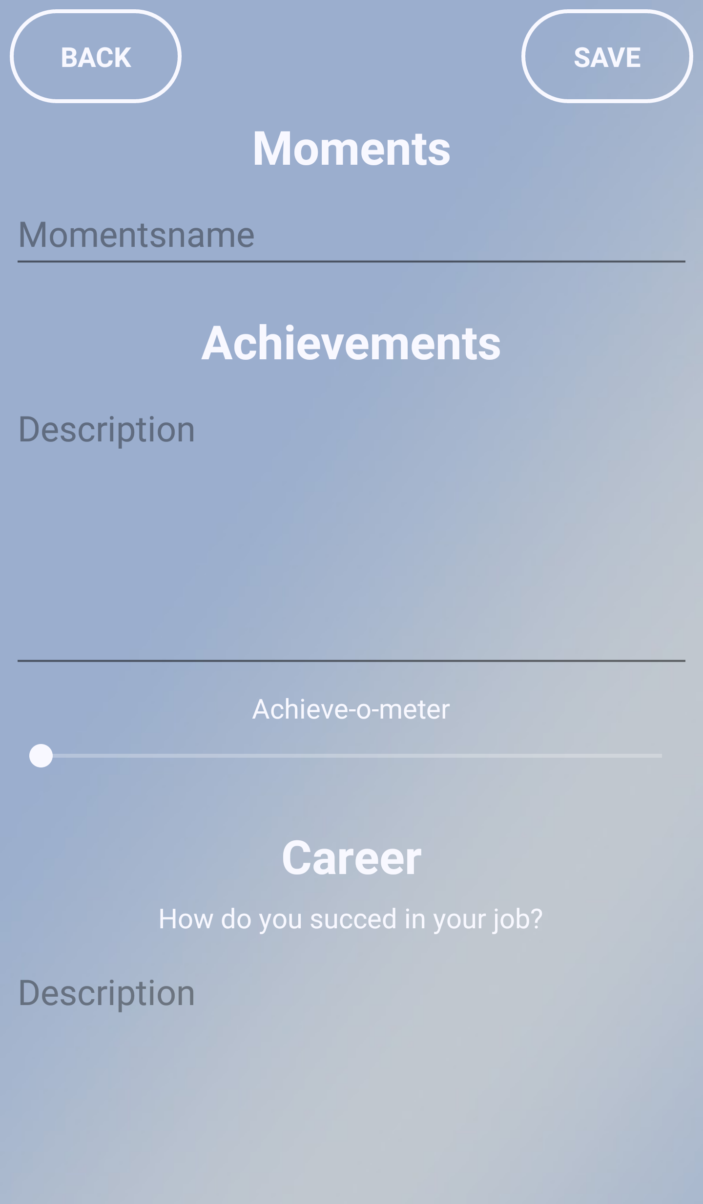
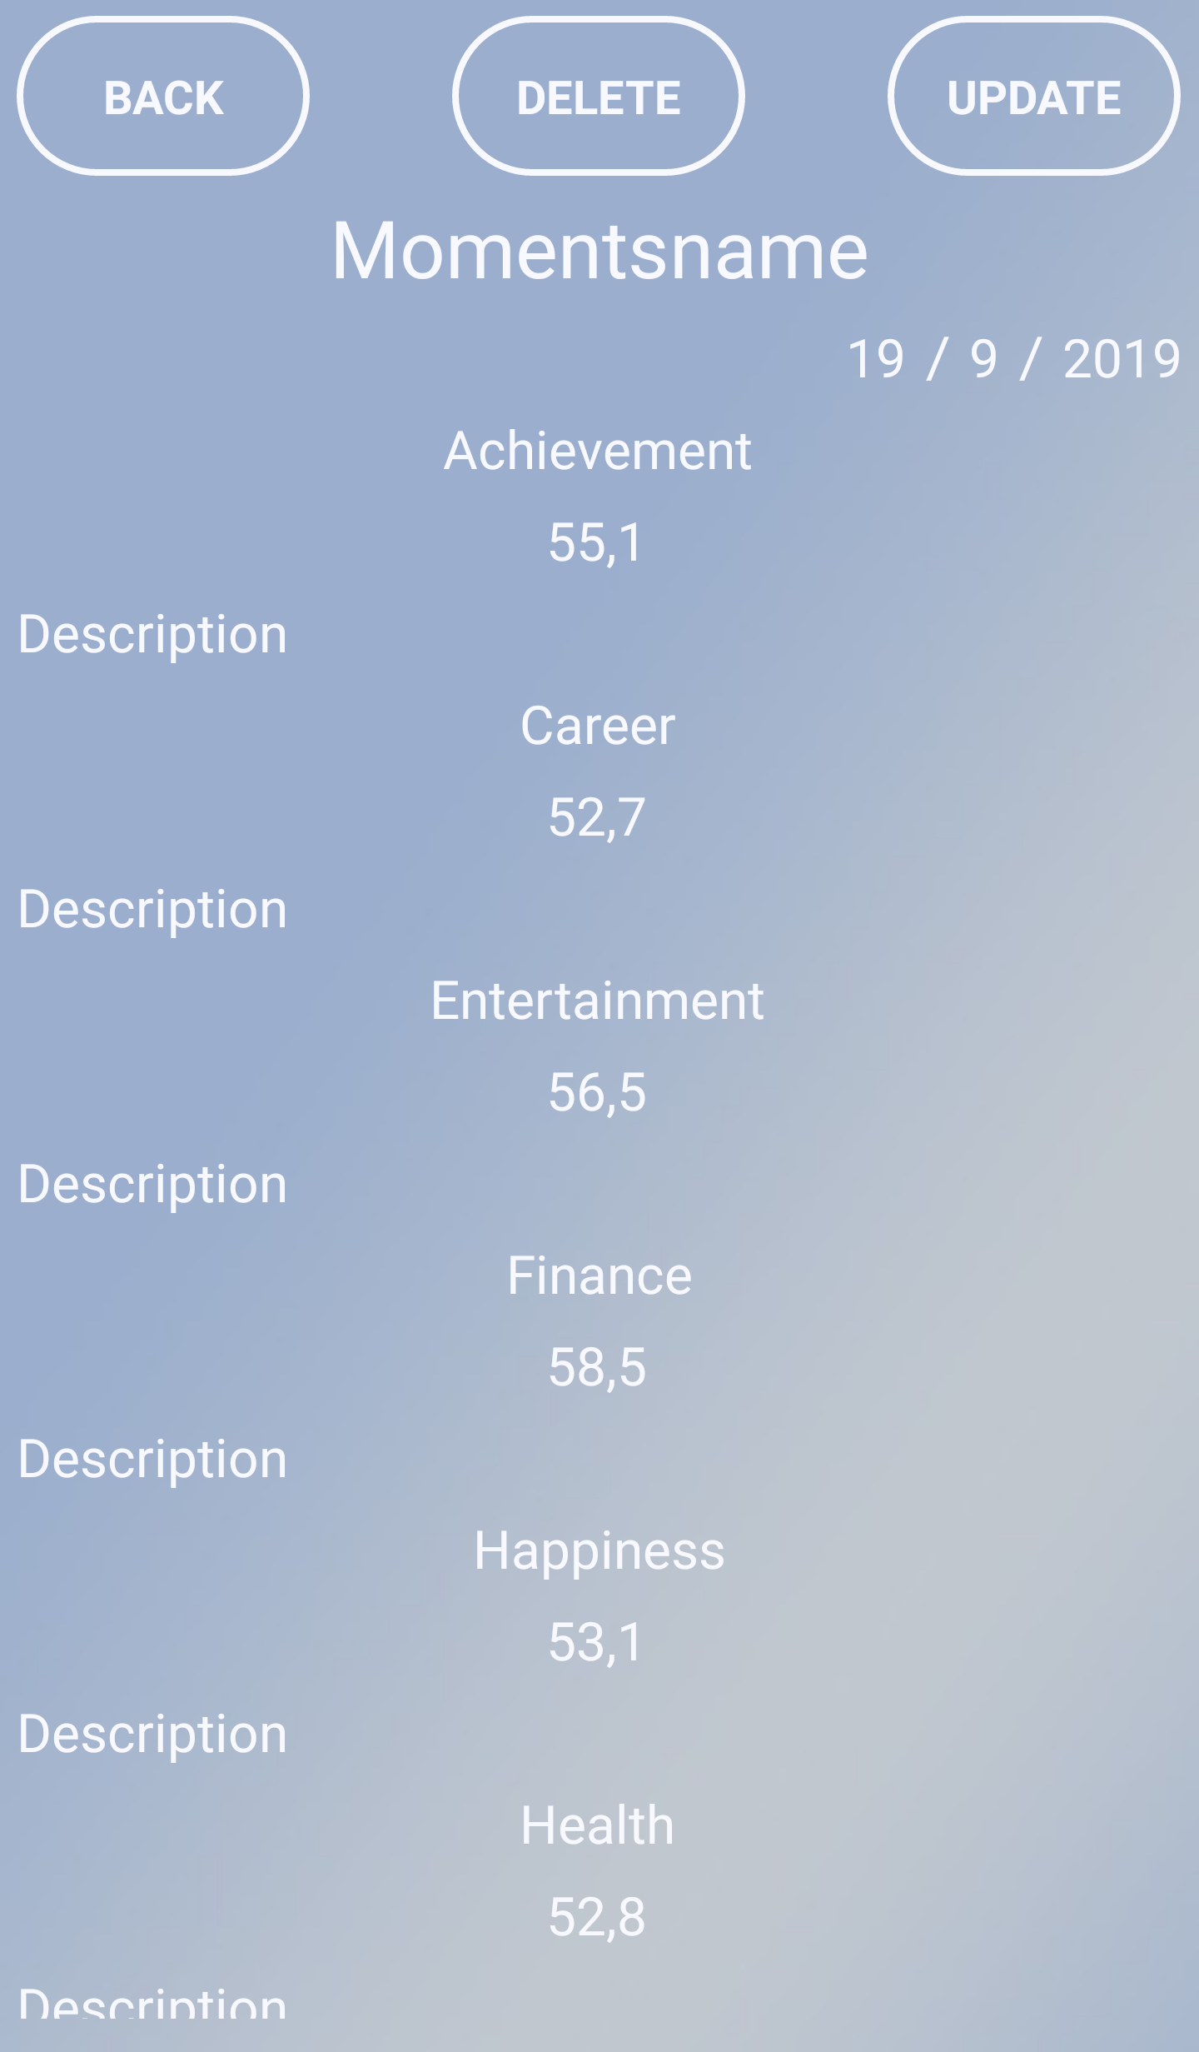
Main features
Moments

Slide 7
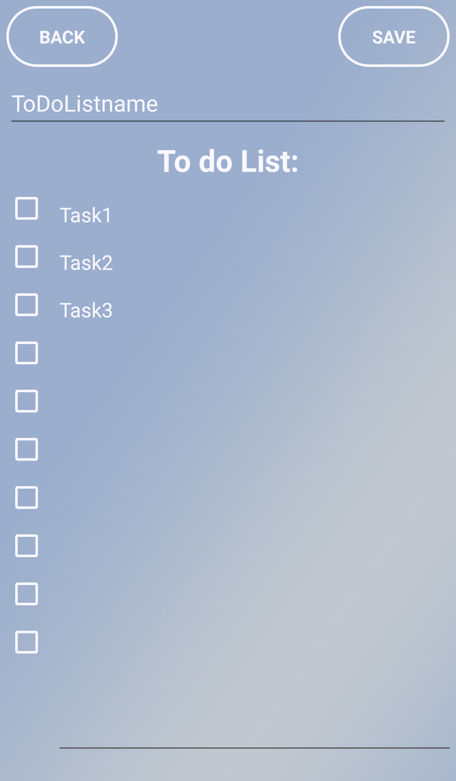
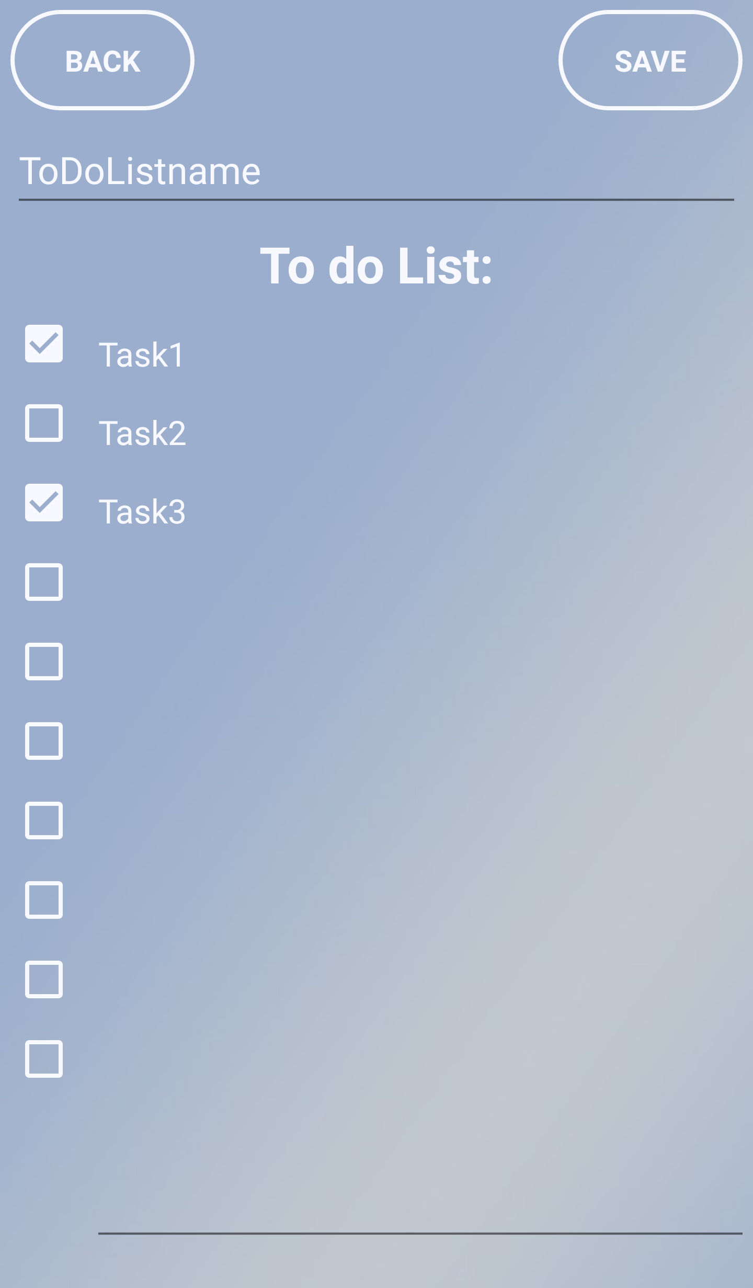
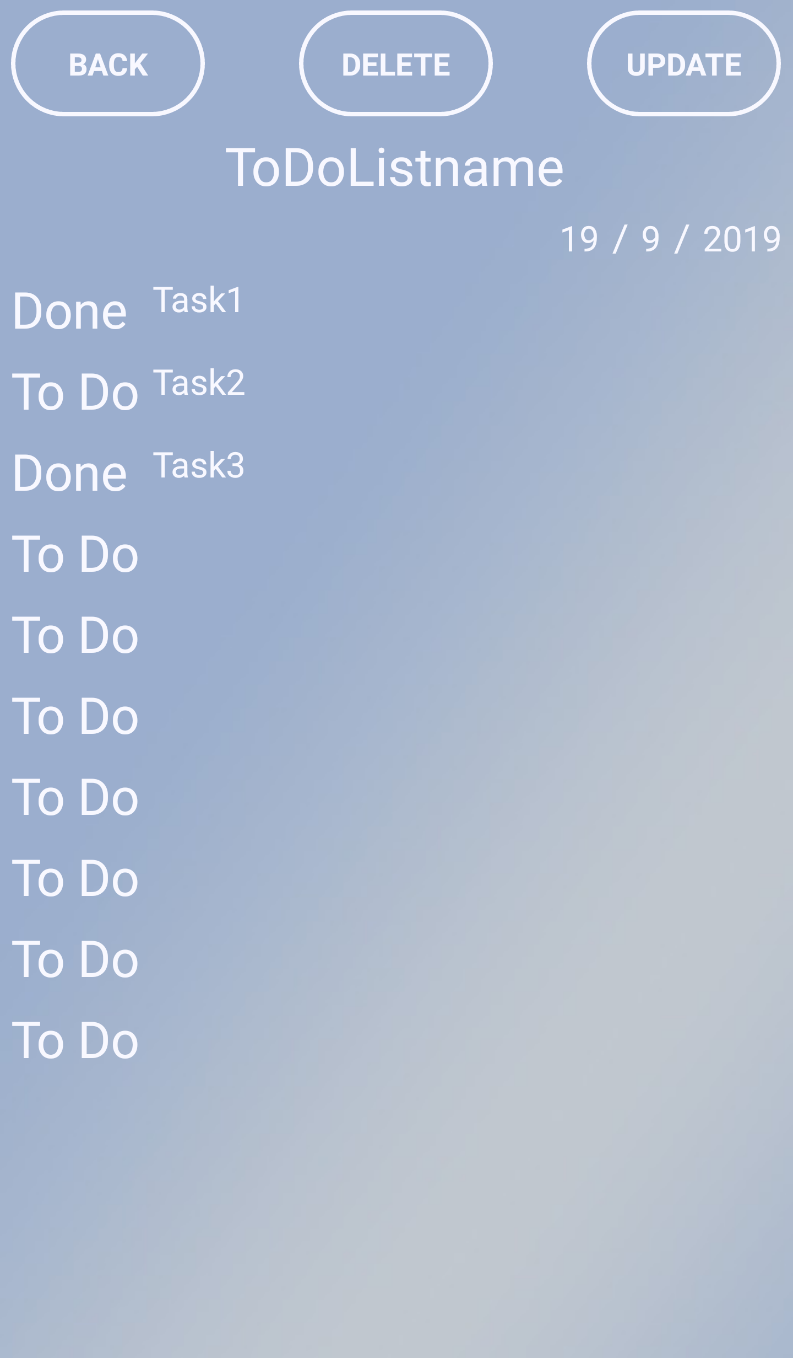
Main features
To Do List

Slide 8
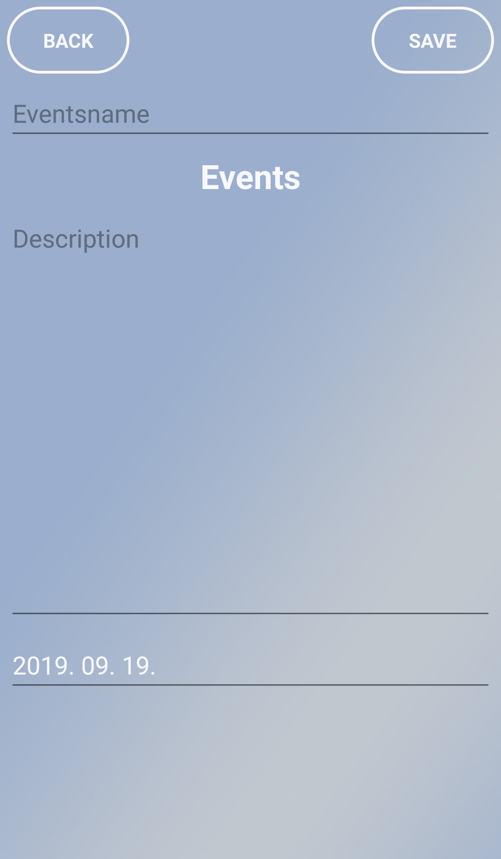
Main features
Events

Slide 9
Database
Moments
int MomentsID
string MomentsName
string Momentsday
string Momentsmonth
string Momentsyear
string Achievement
double AchievementRate
string Career
double CareerRate
string Entertainment
double EntertainmentRate
string Finance
double FinanceRate
string Happiness
double HappinessRate
string Health
double HealthRate
public string Learning
public double LearningRate
string Lovelife
double LovelifeRate
string Sadness
double SadnessRate
string SocialLife
double SocialLifeRate
string SpiritualLife
double SpiritualLifeRate
string WorkOut
double WorkOutRate
Notes
ToDo
Events
int NotesID
string Note
string NotesName
string Notesday
string Notesmonth
string Notesyear
int ToDoID
string ToDoList
string ToDoName
string ToDoday
string ToDomonth
string ToDoyear
int EventsID
string EventsName
string EventsDescriptions
string EventsDate
+createNotes
+readNotes
+updateNotes
+deleteNotes
+createToDo
+readToDo
+updateToDo
+deleteToDo
+createEvents
+readEvents
+updateEvents
+deleteEvents
+createMoments
+readMoments
+updateMoments
+deleteMoments

Slide 10
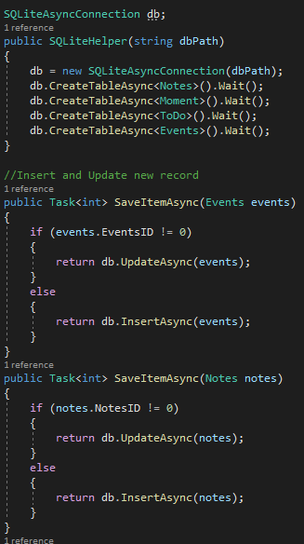
Implementation
How it works

Slide 11
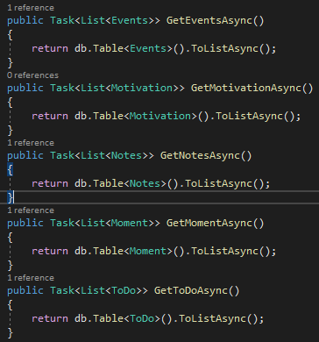
Implementation
How it works

Slide 12
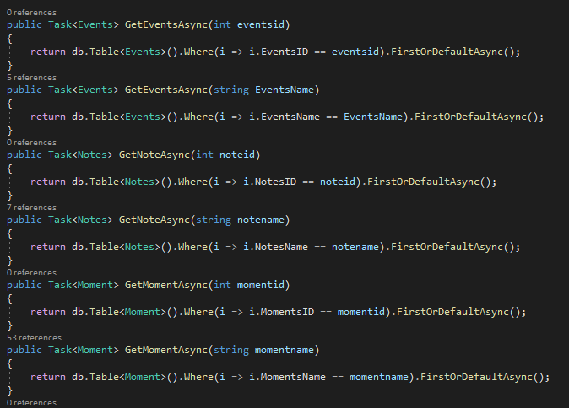
Implementation
How it works

Slide 13
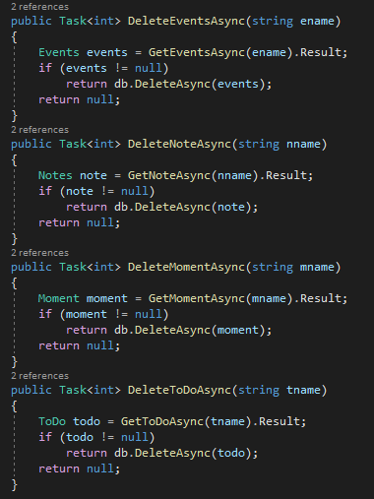
Implementation
How it works

Slide 14
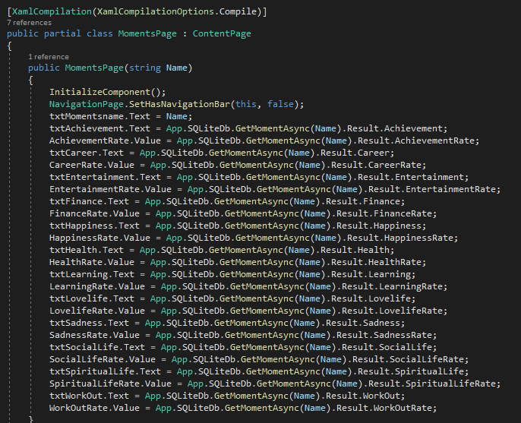
Implementation
Important methods

Slide 15
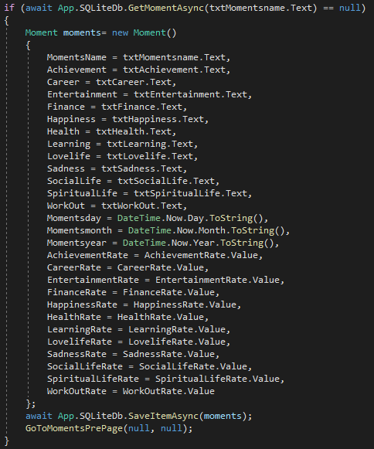
Implementation
Important methods

Slide 16
Implementation
Important methods

Slide 17
Possible future improvements
Time tracker (personal improvement, self-discipline)
Food tracker (fitness goals, mindfulness)
Step counter (active life, goals)
Calendar (organized by day)

Slide 18
Simulation

Slide 19
Thanks for your attention

